Slide 1


Virtual Internship Program 2021

Slide 2

Table of Content
Executive Summary
Business Idea
Issue Tree
Market Landscaping and sizing
Customer Segmentation and Value proposition
Unit Economics
Go to market strategy
Platform & Technology
Growth Drivers
Financials

Slide 3

B
An approach to formulate solution plan, an iterative process
Value Proposition by Segmentation
Unit economics
Customer Segmentation
4
5
Go to Market Strategy
3
6
Market Landscape and Sizing
Structured & Meaningful Business Solution Plan
2
Acquire skillset through comprehensive
problem-solving Toolkit
Platform & Technology
7
Business idea
1
8
Growth Drivers
9
Financials

Slide 4
Group Details
Group Code | TKC_220_IITK
Name of the Project | Instacart
Number of group members | 6
Group Facilitator/SPOC | Subiksha Shree S
S No. | Name | Intern ID | College Name | UG/PG degree | Email | Phone No.
1 | Prajwal Khobre | 57_IIK042_Prajwal | IIT Kanpur | B.Tech | prajwalk@iitk.ac.in | 8275874691
2 | Praveen Prabhat | 57_IITK023_Praveen Prabhat | IIT Kanpur | B.Tech | pravp@iitk.ac.in | 9608873200
3 | Akash Bargat | 57_ | IIT Kanpur | B.Tech | abargat@iitk.ac.in | 9039950588
4 | Subiksha Shree S | 57_IIK009_Subiksha Shree | IIT Kanpur | B.Tech | subiksha@iitk.ac.in | 7708983563
5 | Utkarsh | 57_IIK022_Utkarsh | IIT Kanpur | B.Tech | karshut@iitk.ac.in | 6393937420
6 | Amitabh Sonkar | 57_IIK013_Amitabh | IIT Kanpur | B.Tech | amitson@iitk.ac.in | 9682918512

Slide 5
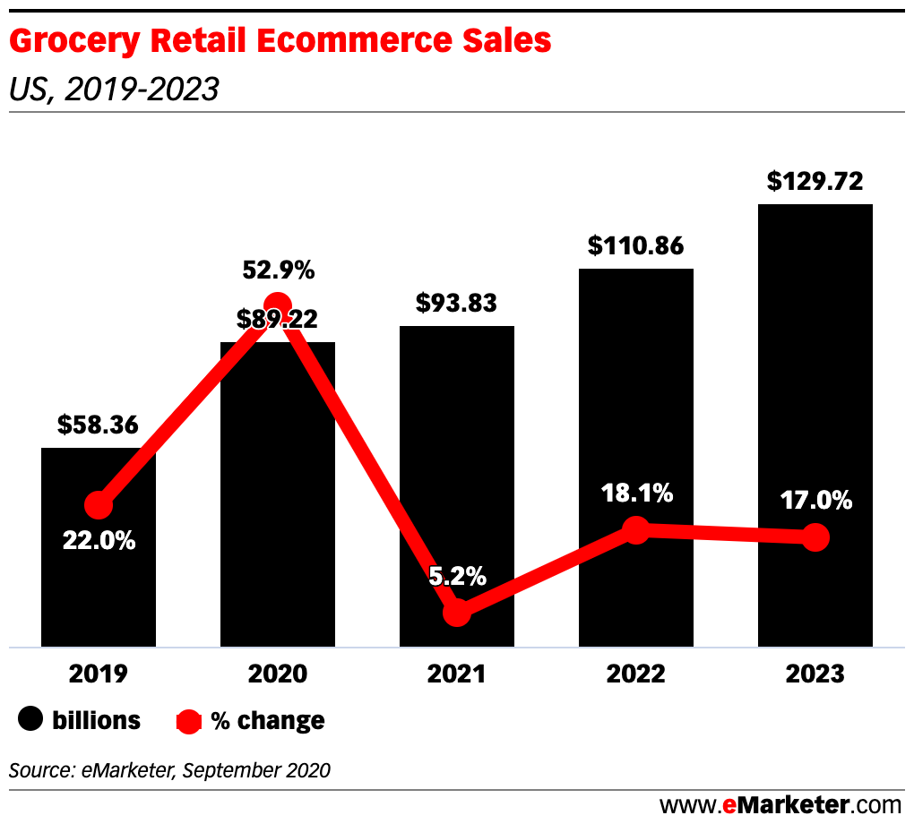
Executive Summary
B
The statistics show that there is a steady growth in the ecommerce grocery sector. Instacart has an upper hand in the prevailing situation
In a way, the pandemic situation has led to the enormous growth of the sector in the previous years.
The fact that the pandemic has not come to an end can help us to expand our target sector
The fear of the contagious disease in the world could be tackled by an innovation using bots for delivery
This could help us in making the delivery faster and help in decreasing the cost spent on employing huge number of man-force for delivery
This might turn the attention of consumers towards us as it would be the first delivery service to implement bots/drones for the transportation

Slide 6
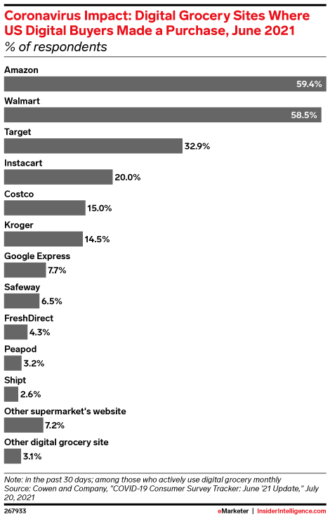
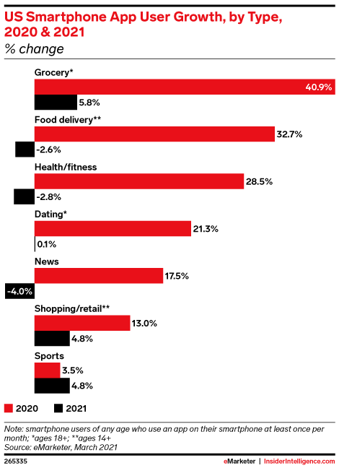
STATISTICS
Having a large share in the market, Instacart has a potential to become the highest contributor in the sector.
The constant demand of groceries will support the growth in all dimensions
Here are a few stats supporting the arguments and facts

Slide 7
B
Business Plan
Overview of the plan
Providing a zero-contact delivery by drones and automated vehicles.
Autonomous drones have unlimited potential to improve everyday life, and our technology opens the way to safe, secure, environmentally friendly deliveries. Given the pandemic condition, the situation can get worse anytime, providing zero contact delivery of essentials might be a revolution in the existing era. This makes people safer and helps the company in cutting down a range of expenses that are spent in employing many people to assist delivery.
Business Case |  | Scope of the Idea
To provide a solution for no contact delivery in pandemic Helps the company by decreasing the expenses and increasing the revenue Easy and quicker of delivery |  | This supports all consumers who are situated in the range of delivery This will be essential for old people as they are less immune and would like to have minimal contact during delivery
Critical Success Factors |  | Value Proposition of the project
Pandemic situation will push people towards opting for the option Ease of the plan would make the customers to repeatedly utilize this new technology for delivery |  | Minimize the contact Make customers feel safer and make the avail the offer

Slide 8
Issue Tree for Drone Delivery
Drone Delivery
Cost
Drone Compatibility
Landscape Issues
Weather Challenges
Civilian Problems
Legal Issues
Purchase Cost
High Payload
Overhead Powerlines
Lightning Strikes
Drone shooting and stealing
Licensing issues
Maintenance Cost
High Range
Bird attacks
Thunderstromes
Package stealing
Privacy rules
New aerodynamic packaging Cost
Fast autonomous system
Improper Landing site for package
Snowfall
Licence Price
Conditional Awareness

Slide 9
F
Factors affecting market landscape
P
Tax policy
Trade policy
Brexit
E
Weather
Climate
Terrain
E
PESTLE
Inflation rate
Economic growth
L
S
Lifestyle attitudes
Demographic factors
Consumer safety
Health concerns
T
Internet speed
Technology awareness

Slide 10
i
Competitive Landscape
Instacart revenue
Instacart users
Year | Revenue
2015 | $120 million
2016 | $185 million
2017 | $300 million
2018 | $525 million
2019 | $735 million
2020 | $1,500 million
Year | Users
2017 | 3.3 million
2018 | 4.3 million
2019 | 5.5 million
2020 | 9.6 million
This statics shows that the revenue generated by the Instacart is getting double in 2019-20 year this shows that the preference on online delivery system.
The health and safety of our community is our number one priority. We are excited to offer contactless delivery through our Leave at My Door delivery feature.
This is pandemic "Leave at My Door" is now the default setting for all Instacart deliveries. Which is most unique and effective step and this leads increase the number of users approx. double that of 2019-20.

Slide 11
Vast selection options
Fast and reliable delivery
Quick customer response towards booking and complains
S
Brand limitations to a certain grocery stores
Higher cost of membership and delivery charges
Lesser competitive unit price
W
Growing online shopping trends
Improvisation of customer experience
Automation technology at various stages of delivery
O
Increasing competition in the sector
Cheaper offline prices
Dissatisfaction caused to a few workers of the company
T

Slide 12
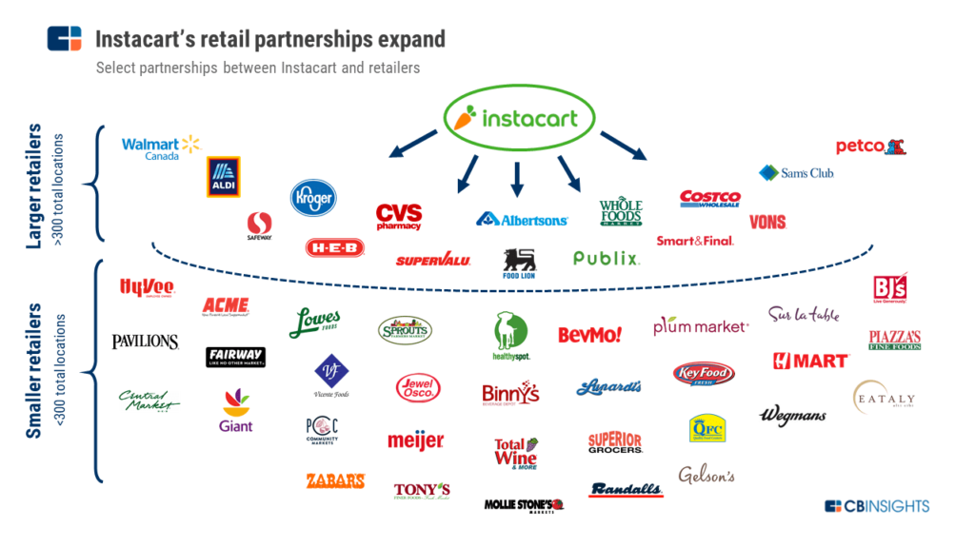




INSTACART VS OTHERS
The general trend of the online market being single/double partnered, Instacart provides a variety of options to the customer and stands out from the crowd. But there are a few reasons why the competitors take a fair share in the market which include better offers, faster response to complaints, availability of products without substitution, cheaper price, etc.

Slide 13
ii
Customer Segmentation
Five Key Criteria for Segmentation
1. Measurable
2. Substantial
3. Accessible
4. Differential
5. Actionable
Segmentation Type | Parameter | Example
Geographic | Regional | North, South, East, West,
 | Living Style | Urban, Suburban
 | Climate | Hot, Cold, Tropical
Demographic | Age | More than 12
 | Gender | Male, Female, Transgender
 | Income | 20-30K, More than 30 K
 | Occupation | Executive, Businessman, Govt Employee
 | Education | School, Graduate, Post-Graduate
 | Generation | Generation X, Millennials
 | Nationality | United States, Canada
 | Social Class | Middle, Upper
Segmentation Type | Parameter | Example
Psychographic | Lifestyle | Culture oriented, Technology oriented
 | Personality | Ambitious, Enthusiastic, Compulsive, Gregarious
Behavioural | Occasions | Regular Occasion, Special Occasion
 | Benefits | Speed, Quality, Service, Economy
 | User Status | Potential user, Existing user
 | Loyalty status | Medium, Strong
 | Readiness stage | Interested, Desirous, Intended to buy
 | Attitude toward product | Enthusiastic, Positive

Slide 14
Value proposition Structural Format
Describe the Transition phase (Past to Present) – Flashbacks
FOR | Young, Tech Savvy users
WHO | want cost-effective, fast and environment friendly delivery
OUR | Drone Delivery App
PROVIDES | fast, contactless deliveries to any region
WITH (Our brand) | this App, just buys things and high-speed drones deliver the groceries at doorstep, keep track of it on cell phone and pay easily through our app.

Slide 15
UNIT ECONOMICS
Defining one unit as "One Customer".
Unit Economics(UE) = Customer lifetime value (LTV) / Customer acquisition cost (CAC)
Customer lifetime value (LTV) = (T x AOV x AGM x ALT) / number of customers for a given period
Customer acquisition cost(CAC) = sales and marketing costs / number of acquired customers
T = average number of transactions
AOV = average value of an order
AGM = average gross margin
ALT = average lifetime of a customer (churn rate)
Total Revenue = $ 1500 millions
Total users = 9.6 millions

Slide 16
Calculations
T(Avg. No. of transactions) = 9,600,000 * 1.50 = 14,400,000
Guesstimates
1. Cost = $ 500 millions
2. Marketing cost = $ 250 millions
AOV (Avg. value of an order) = 1500,000,000 / 14,400,000 = 104
AGM (Avg. gross margin) = (1000,000,000 / 1500,000,000) = 0.66
ALT (Avg. lifetime of a customer (churn rate)) = (9.6 - 5.5) / 9.6 = 0.42
Customer lifetime value (LTV) = 43.24
Customer acquisition cost(CAC) = 250,000,000 / 9,600,000 = 26.04
UNIT ECONOMICS (UE)= 43.24 / 26.04 = 1.66
ANALYSIS
LTV is greater than CAC, it indicates that our business is strong.

Slide 17
Platforms and Technology Used
Last mile of delivery is the most expensive part of the supply chain as it leaves a shipping containers and it enters the smallest vehicle with only a few items.
Autonomous drones and UAVs could turn out to be a solution being cost & time efficient with technically viable.
Ordered
Packed
Shipped
Delivery

Slide 18
Technology Needed
Company's End
Fast & autonomous systems for drones
Efficient sensors for real time flight data collection
ML & AI for the better conditional awareness of the drones
Data analysis
High performance battery
High payload capacity drones
Customer's End
QR code printed landing sites for drones

Slide 19
Growth Drivers
1. Drones can reach all types of terrains.
2. Advancement in sensors.
3. Emergence of low-cost drones.
4. Increased funding offered by venture capitalists.
5. Emerging e-commerce and retail sectors worldwide.
6. Increasing demand for faster delivery.
7. Increasing demand for decreasing the carbon emissions.
8. Amendments in regulatory frameworks in encouraging drone-package delivery.
9. Lower maintenance cost.
10. Expansion into new customer segments.
11. Growth of emerging areas.
12. Expanded service offerings.
13. Possibility to reach in unsafe environments e.g. natural disasters.
14. Reduction of human involvement to save costs.

Slide 20
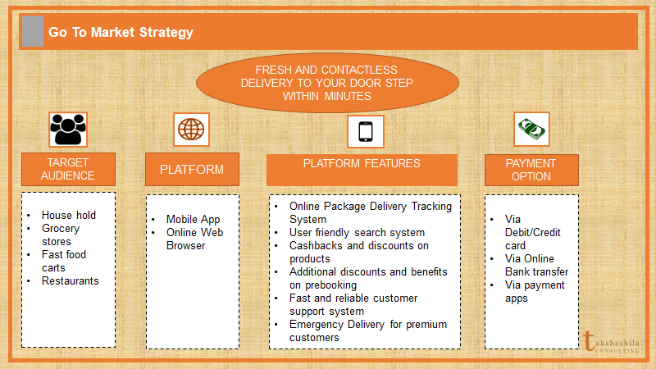

Slide 21
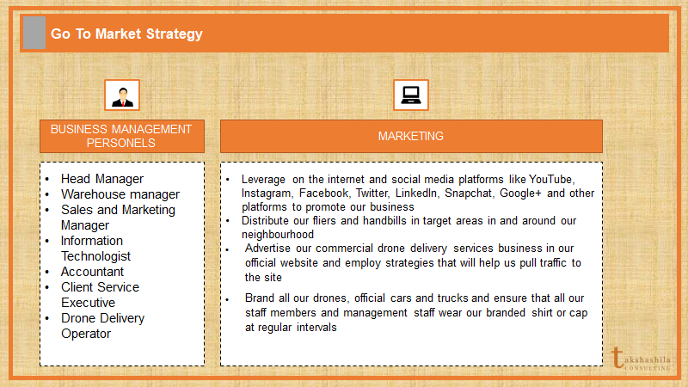

Slide 22
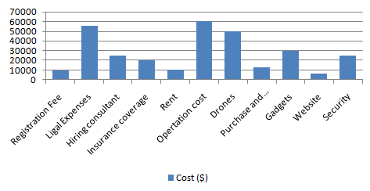
Finance
Cost analysis

Slide 23
The coronavirus pandemic, drives the finance of Instacart hit its first profitable month, netting $10 million.
"Leave at My Door" concept made Instacart to reach on large scale of user for varied demographics and according to report 2020 it has an estimated 9.6 million active users along with over 500,000 shoppers who pick up the items with 600 Partners refers to retail and grocery companies that operate on Instacart.
According to Fortune and TechCrunch valuation of Instacart in 2021 is $39 billion which is 3fold then 2020.

Slide 24
References
https://www.businessofapps.com/data/instacart-statistics/
https://gigsdoneright.com/amazon-fresh-vs-instacart/
https://www.supermarketnews.com/online-retail/target-launches-enhanced-online-grocery-pickup
https://www.emarketer.com/topics/category/instacart
https://www.entrepreneur.com/article/378694
https://www.digitalcommerce360.com/2021/07/29/instacart-invests-in-robots-in-bid-to-boost-fulfillment/
https://nocamels.com/2021/07/instacart-israel-fabric-automated-fulfillment/
https://www.forbes.com/sites/brittainladd/2019/02/11/killing-instacart-why-the-company-is-at-risk-of-crashing-to-the-ground/?sh=31e6c26a36e8
https://www.digitalcommerce360.com/2020/06/12/why-independent-grocers-should-avoid-instacart-and-similar-services/

